Slide 1
ZERO HUNGER
AN EFFORT FOR BETTER AND SMARTER FOOD WASTE MANAGEMENT

Slide 2
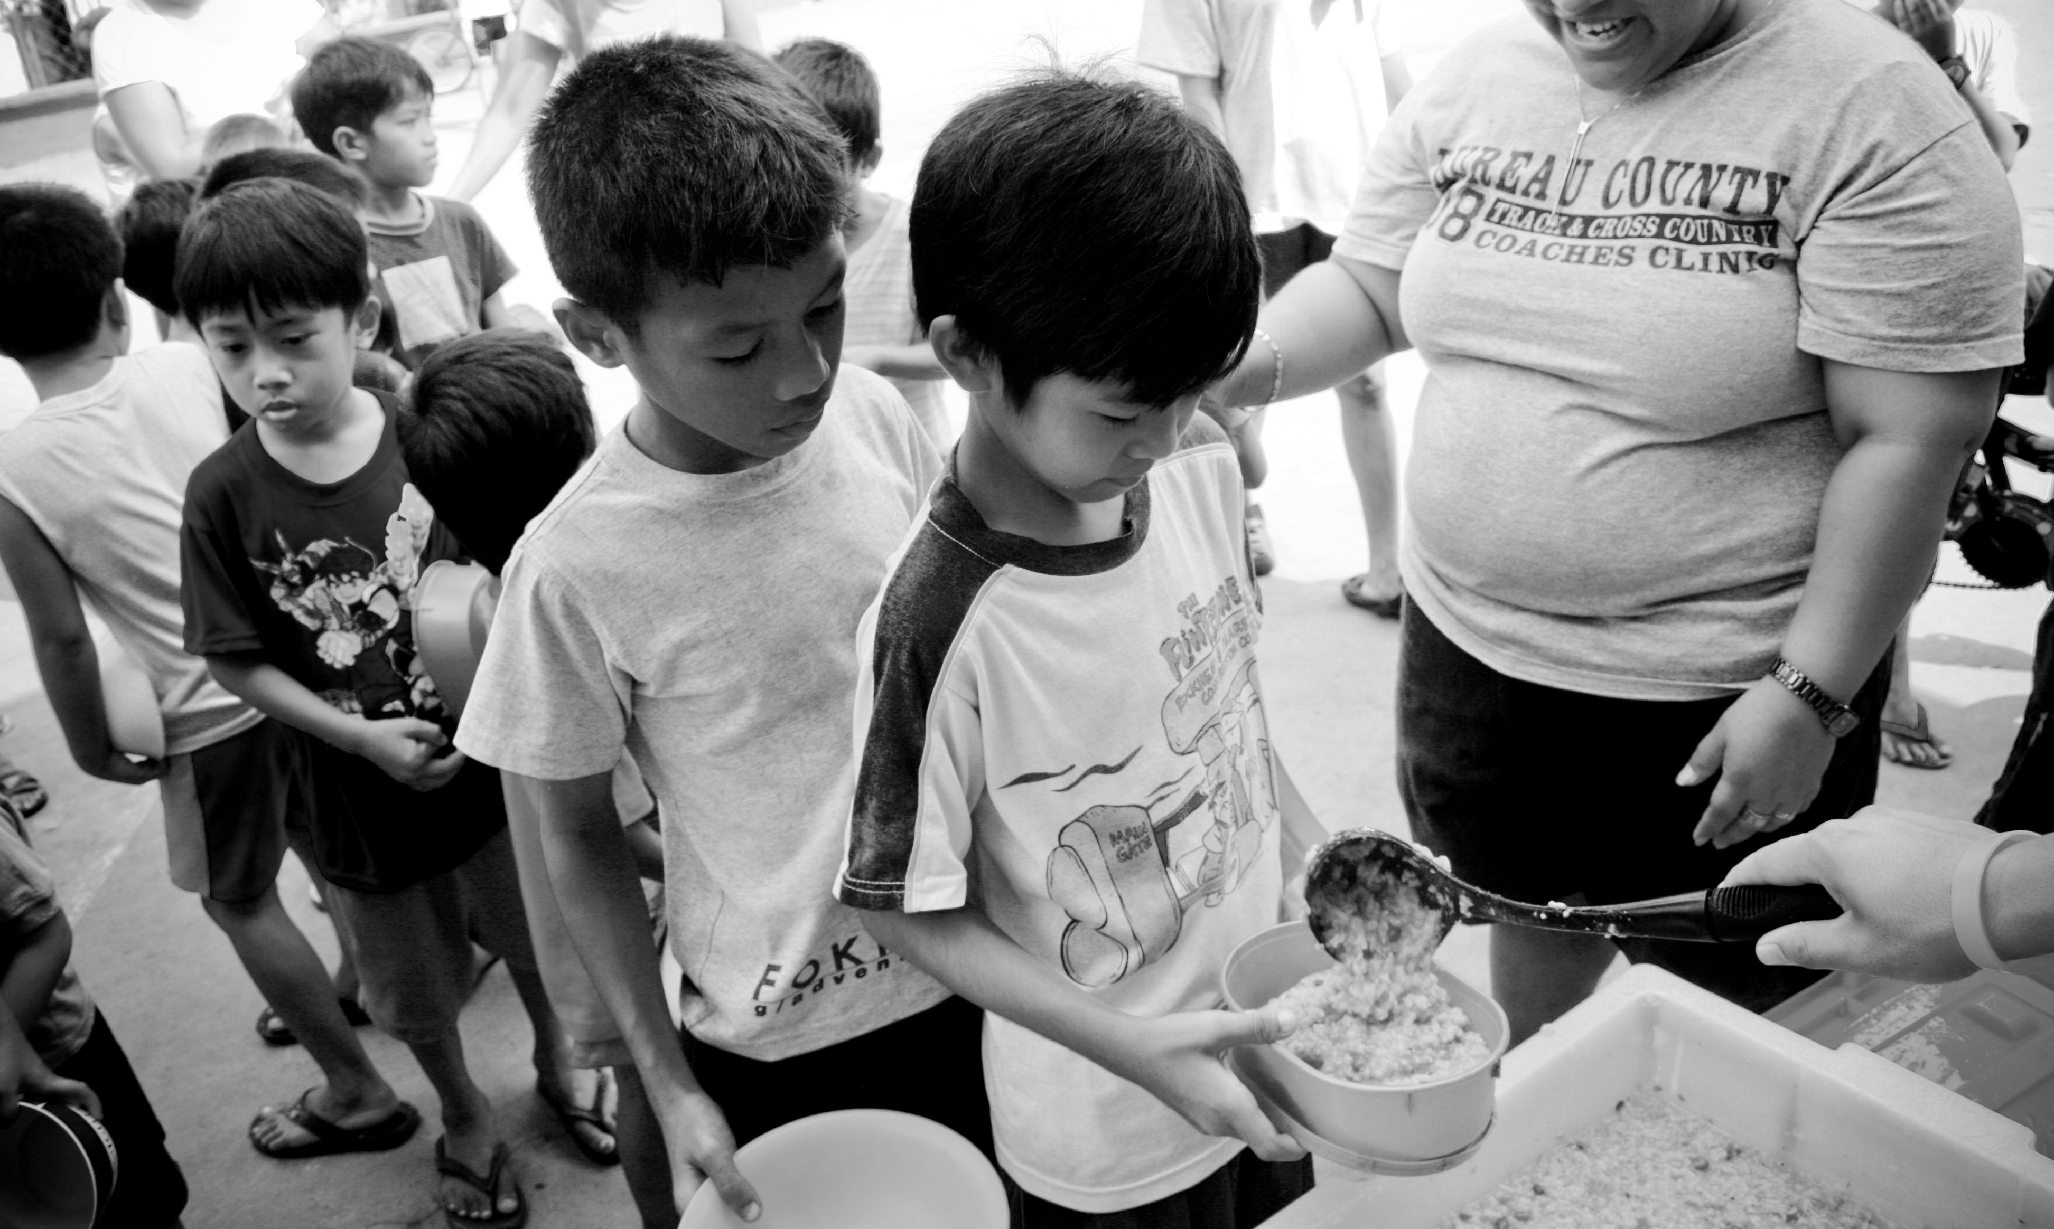
THE
PROBLEM
Even with millions dying of hunger every year,
Food is still being thrown out everyday as "waste".

Slide 3
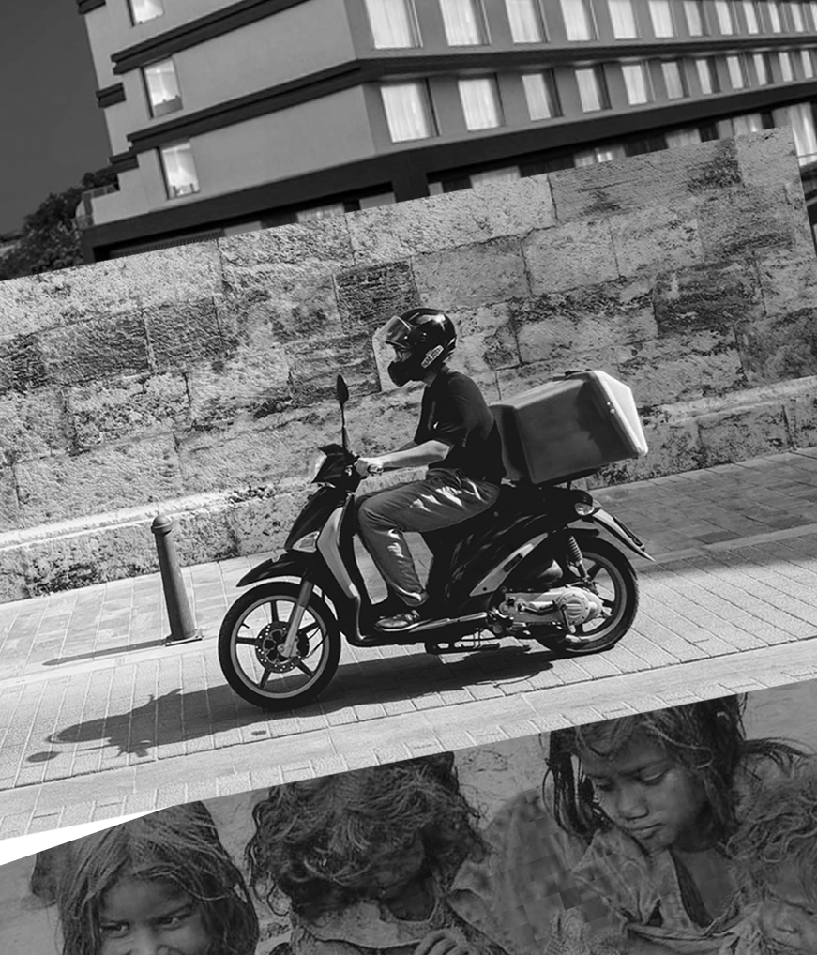
Hotels
"Waste" from hotels is enthusiastically collected by us and sent to be stored in inventory.
Delivery Agents
[3 BIRDS 1 STONE]
Our delivery agents are volunteers registered through our portal where they can choose their shifts, be it day or night.
WHAT MAKES ZERO HUNGER SMART
Rain Baseras
Rain Baseras provided by the government only provide shelter to the downtrodden. We take it a step further by providing them food at dirt cheap prices.

Slide 4
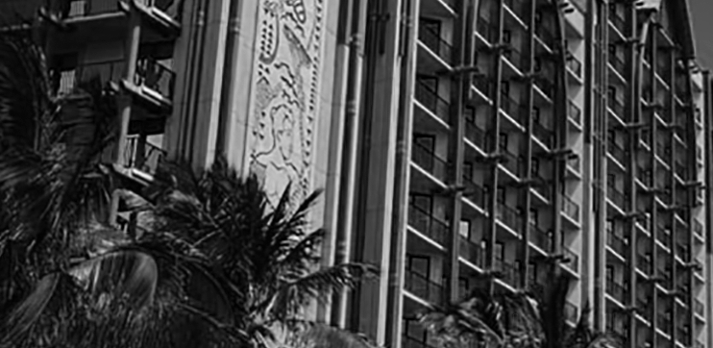

WHY
HOTELS?
The Hotel Industry being one of the biggest generators of food waste, made it the best target for us to start cleaning up from. Hotels also produce a steady and consistent amount of food waste irrespective of seasons or social trends.

Slide 5


TRANSPORTATION THROUGH AN UNTAPPED ASSET
There has been a stark rise in the no. of delivery agents all around India over the last few years.
These underpaid workers usually work part-time and are untapped assets willing to volunteer for a quick buck.

Slide 6
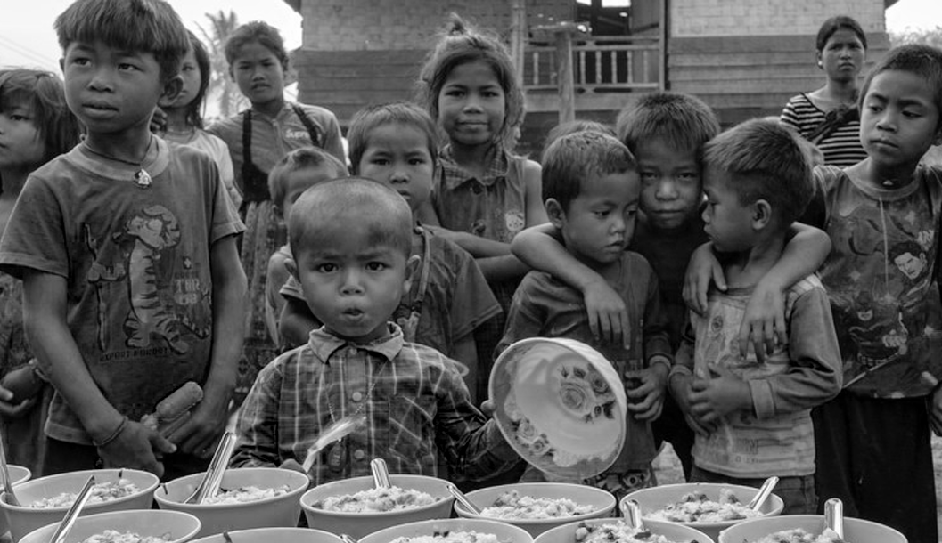
FEEDING THE POOR, A FEW HUNDRED AT A TIME
Instead of going out ourselves and distributing food among the impoverished, we have found the perfect target for distribution to the homeless and famished in Rain Baseras.

Slide 7
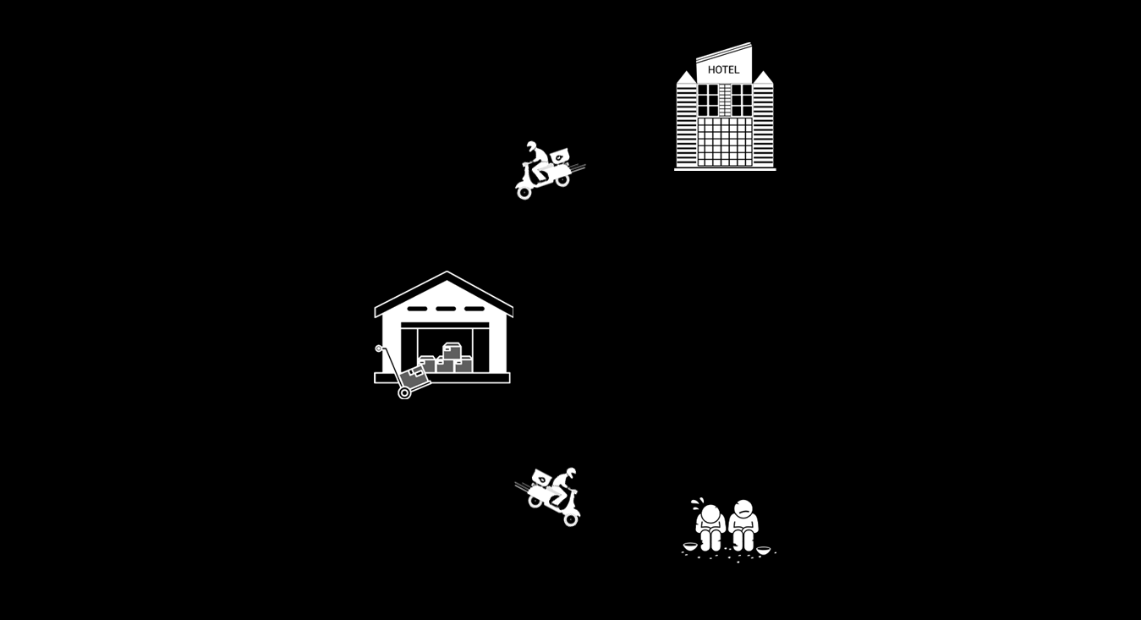

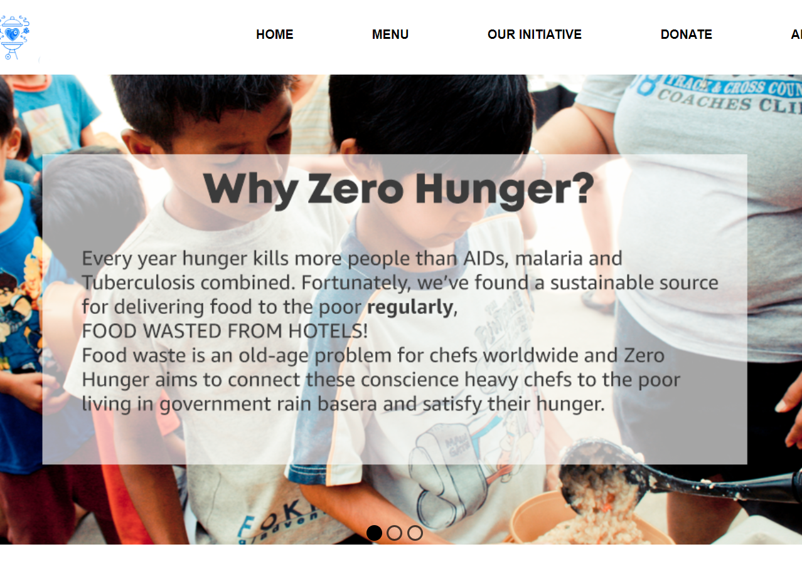
WORKFLOW

Slide 8
The Financials
₹100
₹6-7
per driver per shift
per person
The volunteer drivers are given around ₹100 per shift to carry approx. 10-20 KGs of food.
The rain basera community head can sell the food provided to them at measly price of approximately ₹7.
Expenditure
Earning
<
Total Expenditure
2 shifts * 2 drivers*100
=₹400
Total Earning
70 avg. inhabitants* ₹7
=₹490

Slide 9

FUTURE
POSSIBILITIES
We could also add Hotspot detection and aim to work for the bottom 1% of the population.
With increase in the no. of rain baseras and hotels working with us, we could increase our network of distribution.
The collection sites can be extended to banquets and farm-houses in wedding seasons.

Slide 10
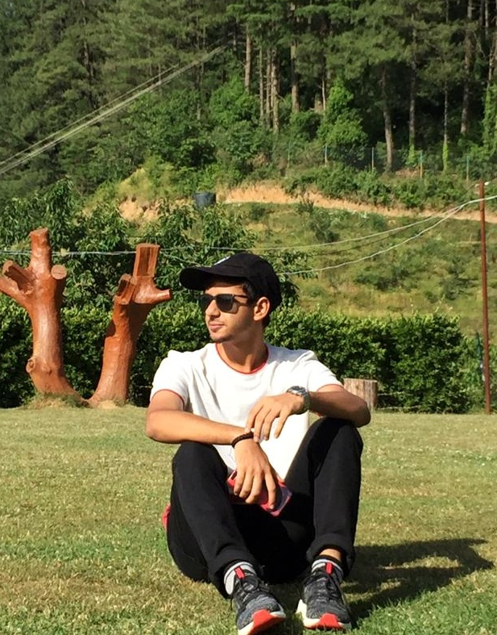
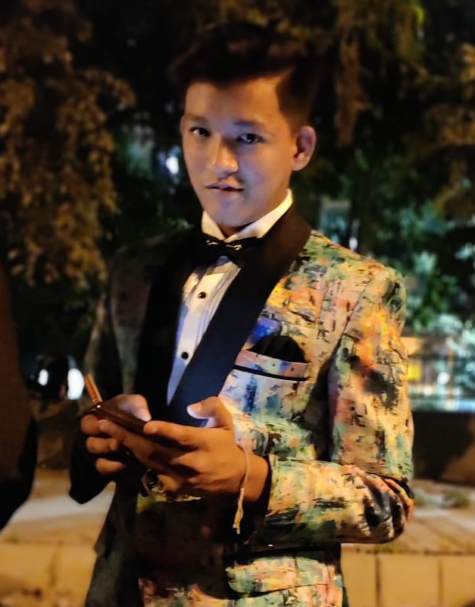
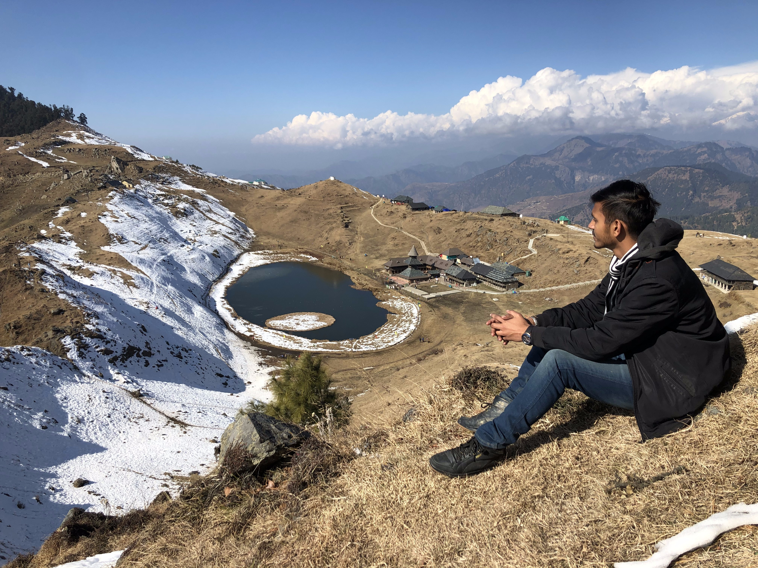
JATIN KUSHWAH
MEET
F_SOCIETY
JIVESH SINGH
RAJ JHUNJHUNWALA

Slide 11
THANK YOU

